Slide 1

Cryptographic Failures (A02:2021)
Safeguarding Customer Information
Presented by: Abby Gopal
Notes:
Good morning/afternoon everyone, and welcome to this presentation on safeguarding customer information at Walmart. As you know, data security is paramount in today's digital age, especially in the retail industry where we handle sensitive customer information like personal details and payment methods. Today, we'll focus on a specific threat: cryptographic failures, which can have severe consequences. We'll explore what they are, their impact on Walmart, and how we can work together to minimize them.

Slide 2

Introduction Protecting Walmart’s Sensitive Information
Significance of Data Security
Emphasize the crucial role of data security.
Highlight its impact on customer trust and Walmart's reputation.
Focus on OWASP Top 10 - A02:2021 - Cryptographic Failures
Introduce the specific security risk: A02 - Cryptographic Failures.
Clarify the presentation's objective: Understanding and minimizing cryptographic failures.
Notes:
Significance of Data Security:
Crucial Role: Highlight that data security plays a crucial role in the retail industry, especially for a giant like Walmart. It's not just a technical requirement but a cornerstone of customer trust and satisfaction.
Impact on Reputation: Emphasize that the retail industry relies heavily on reputation, and any compromise in data security can have severe repercussions on Walmart's standing and customer loyalty.
III. Focus on OWASP Top 10 - A02:2021 - Cryptographic Failures:
Introduction to A02: Introduce the specific security risk, A02 - Cryptographic Failures, from the OWASP Top 10 (2021).
Presentation Objective: Clearly state the goal of the presentation - to help stakeholders understand and minimize cryptographic failures, focusing on A02.

Slide 3
Organization Details
Industry: Retail
Company: Walmart Inc.
Product/Service: Walmart is a multinational retail corporation that operates a chain of hypermarkets, discount department stores, and grocery stores. The company provides a wide range of products, including consumer electronics, clothing, groceries, household goods, and more. Walmart has a significant online presence, offering e-commerce services through its website and mobile applications.

Slide 4

Understanding Cryptographic Failures
Cryptographic failures: Improper use or implementation of encryption mechanisms.
Examples: Weak algorithms, insecure key management, unencrypted data transmission.

Slide 5
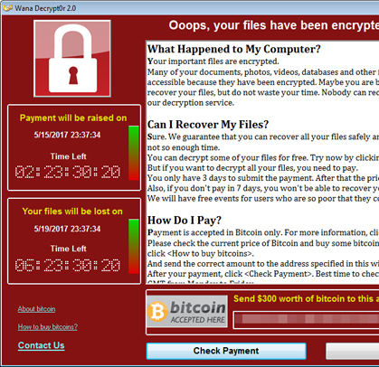
Real-World Impact WannaCry Ransomware Attack (2017)
Overview:
Occurred in 2017, targeting global computers using Microsoft Windows.
Cryptographic Failure Connection:
Exploited a vulnerability in the Windows operating system, particularly through the EternalBlue exploit.
Manipulated encryption protocols, especially SMB (Server Message Block), to facilitate rapid ransomware spread.
Consequences:
Disrupted critical services across various sectors, impacting healthcare institutions and businesses.
Demonstrated cascading effects of cryptographic failures, leading to widespread data encryption and ransom demands.
Emphasized the crucial need to promptly address vulnerabilities and maintain up-to-date cryptographic defenses.
Notes:
Imagine encryption as a lock protecting our data. Cryptographic failures are like cracks in that lock, making it easier for attackers to access sensitive information. These failures can occur due to various reasons, like using weak encryption algorithms that are easily breakable, not managing encryption keys securely, or even transmitting data without encryption at all. These failures have real-world consequences, as seen in the Equifax breach, where millions of customers' data were exposed due to insufficient encryption, and the WannaCry attack, which crippled organizations globally by exploiting weak encryption.

Slide 6
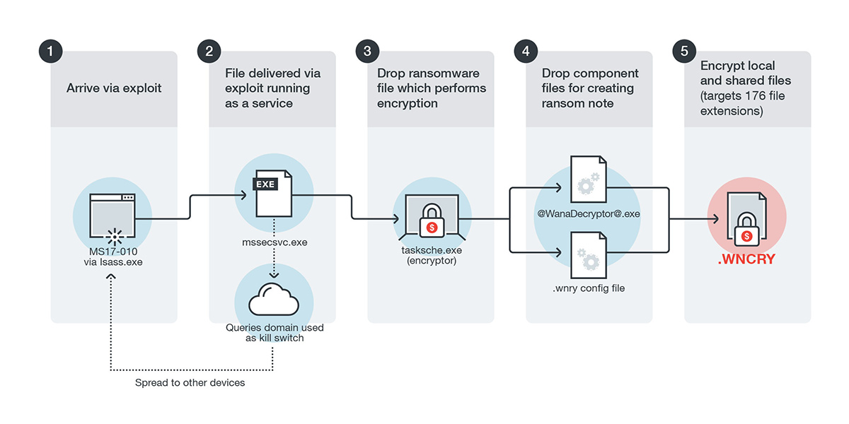
WannaCry Ransomware Attack
Infection Diagram
Notes:
Link: https://www.trendmicro.com/en_us/research/17/e/massive-wannacrywcry-ransomware-attack-hits-various-countries.html

Slide 7
Why is it Crucial for Walmart?
Protects sensitive customer data (personal information, payment details).
Ensures compliance with data protection regulations (PCI DSS, GDPR).
Maintains customer trust and brand reputation.
Reduces risks of financial fraud and data breaches.
Notes:
At Walmart, protecting customer information is not just a technical issue, it's a core value. Strong encryption plays a vital role in achieving this. It safeguards sensitive data like names, addresses, and payment details, preventing unauthorized access and potential misuse. Additionally, complying with data protection regulations like PCI DSS and GDPR is mandatory, and robust encryption is crucial for meeting these requirements. Furthermore, strong encryption builds trust with our customers, demonstrating our commitment to data security. Ultimately, it helps us mitigate the risks of financial fraud and data breaches, protecting our customers and our business.

Slide 8
Impact on Different Teams Developers
Secure coding practices:
Implement input validation to prevent SQL injection and other vulnerabilities.
Use secure coding libraries and frameworks to avoid common mistakes.
Write code that is well-documented and easy to understand for security reviews.
Stay up-to-date on the latest security vulnerabilities and patching techniques.
Use industry-standard algorithms and libraries:
Choose encryption algorithms that are strong and well-supported, such as AES or ChaCha20.
Use libraries and frameworks that have been rigorously tested and have a good security track record.
Avoid using custom or outdated cryptographic solutions.
Notes:
Minimizing cryptographic failures requires a collaborative effort across all teams at Walmart. Our developers play a crucial role by adopting secure coding practices and using industry-standard encryption algorithms and libraries. The security engineers are responsible for identifying vulnerabilities through scanning and penetration testing, and implementing robust key management protocols to protect encryption keys. The operations team ensures secure server configurations and promptly patches software vulnerabilities to address known security risks. Finally, our executive management plays a vital role in recognizing the importance of data security, allocating necessary resources, and supporting security initiatives across the organization.

Slide 9
Testers
Vulnerability scanning and penetration testing:
Regularly scan systems for known vulnerabilities, including cryptographic weaknesses.
Conduct penetration testing to simulate real-world attacks and identify exploitable weaknesses.
Prioritize the remediation of vulnerabilities based on their severity and risk.
Robust key management protocols:
Implement strong key generation practices, using secure random number generators.
Store keys securely, using hardware security modules (HSMs) or other tamper-resistant solutions.
Rotate keys regularly to reduce the risk of compromise.
Implement granular access controls to limit who can access and use keys.

Slide 10

Technical Managers
Secure server configurations:
Harden server configurations to follow industry best practices such as disabling unnecessary services and closing unused ports.
Keep software up-to-date with the latest security patches.
Monitor system logs for suspicious activity and investigate potential breaches promptly.
Patch software vulnerabilities promptly:
Have a process in place to identify, prioritize, and deploy security patches promptly.
Test patches in a non-production environment before deploying them to production.
Communicate patching schedules and potential impacts to stakeholders.

Slide 11
Non-Technical Managers
Recognize the risk and allocate resources:
Understand the risks associated with cryptographic failures and their potential impact on the business.
Allocate sufficient resources to implement and maintain effective security controls.
Foster a culture of security awareness throughout the organization.
Support security initiatives across the organization:
Provide clear direction and support for security initiatives from the top down.
Empower employees to report security concerns and participate in security awareness training.
Hold teams accountable for meeting security objectives.

Slide 12

Best Practices to Minimize Failures
Use strong encryption algorithms (AES -256, ChaCha20).
1
Implement secure key management (rotation, storage, access control).
2
Enforce HTTPS on all web pages and applications.
3
Use secure hashing algorithms (SHA-256, bcrypt).
4
Sanitize user input to prevent vulnerabilities (SQL injection).
5
Regularly patch and update software.
6
Educate employees on secure password practices and phishing scams.
7
Conduct regular security audits and penetration testing.
8
Notes:
By implementing these best practices, we can significantly reduce the risk of cryptographic failures at Walmart. Firstly, we must use strong and up-to-date encryption algorithms like AES and ChaCha20. Secondly, secure key management is crucial, involving regular key rotation, secure storage, and limited access control. Additionally, enforcing HTTPS on all web pages and applications ensures data is encrypted during transmission. Furthermore, using secure hashing algorithms like SHA-256 and bcrypt protects sensitive data like passwords

Slide 13
CWE Resources and Further Learning
Weak algorithms (CWE-327): Using outdated ciphers like MD5 for password hashing, making them susceptible to cracking attacks.
Insecure key management (CWE-311, CWE-312): Weak key generation,improper storage (plain text, easily guessable passwords), and infrequent key rotation can compromise data security.
Unencrypted data transmission (CWE-319): Sending sensitive information like credit card details in plain text over the internet makes it vulnerable to interception by attackers.
Outdated libraries and software (CWE-306): Using known vulnerable libraries or outdated software versions leaves systems exposed to patched vulnerabilities.
Notes:
Weak Algorithms (CWE-327):
Imagine locking your store with a simple padlock (MD5) vs. a high-security deadbolt (AES-256). Weak algorithms can be cracked by attackers, exposing sensitive data like passwords and payment information.
Are you still using MD5 for password hashing? Consider migrating to secure algorithms like bcrypt or SHA-256 for more robust protection.
Insecure Key Management (CWE-311, CWE-312):
Think of your keys as the digital guardians of your data. Storing them in plain text is like leaving the store door wide open!
Do you have strong key generation practices? Are keys stored securely using hardware security modules (HSMs) or encrypted at rest? Regular key rotation is crucial to prevent unauthorized access.
Unencrypted Data Transmission (CWE-319):
Sending sensitive information across the internet without encryption is like sending postcards with your credit card details! Attackers can easily intercept and steal this data.
Is all communication on your online store website, including logins and transactions, encrypted with TLS/SSL? Ensure secure connections to protect customer data in transit.
Outdated Libraries and Software (CWE-306):
Using outdated software with known vulnerabilities is like having a patched roof with a hidden leak. Attackers can exploit these vulnerabilities to gain access to your systems.
Do you keep your software and encryption libraries up-to-date with the latest security patches? Regularly update all components to address potential vulnerabilities.
https://owasp.org/Top10/A02_2021-Cryptographic_Failures/
CWE-327: Use of a Broken or Risky Cryptographic Algorithm (4.1). (2019, July 19). Cwe.mitre.org. https://cwe.mitre.org/data/definitions/327.html
CWE-306: Missing Authentication for Critical Function (4.6). (2019, July 19). Cwe.mitre.org. https://cwe.mitre.org/data/definitions/306.html
CWE-311: Missing Encryption of Sensitive Data (4.4). (2019, July 19). Cwe.mitre.org. https://cwe.mitre.org/data/definitions/311.html
CWE-312: Cleartext Storage of Sensitive Information (4.4). (2019, July 19). Cwe.mitre.org. https://cwe.mitre.org/data/definitions/312.html
CWE-319: Cleartext Transmission of Sensitive Information (4.3). (2019, July 19). Cwe.mitre.org. https://cwe.mitre.org/data/definitions/319.html

Slide 14

Call to Action Building a Secure Future at Walmart
Collaboration is key
Share knowledge across teams
Report vulnerabilities promptly
Work together on solutions
Continuous improvement
Stay informed about evolving threats and best practices
Conduct regular security assessments and training
Adapt and refine security posture over time

Slide 15
Invest in security training
Empower employees to identify and report suspicious activity
Foster a culture of security awareness
Equip employees with the knowledge to defend against threats
Prioritize security throughout the development lifecycle
Integrate security practices into all phases of development
Conduct security testing early and often
Build security into applications and infrastructure

Slide 16

Conclusion
Crypto shields Walmart: Protects operations and customer data.
Encryption & keys: Lock down sensitive information.
Stay updated: Regular checks and tests for strong security.
Trust & reputation: Strong security builds customer trust.
Adapt & invest: Stay ahead of evolving cyber threats.

Slide 17
Resources
Common Weakness Enumeration (CWE) website
CWE-327: Use of a Broken or Risky Cryptographic Algorithm (4.1). (2019, July 19). Cwe.mitre.org. https://cwe.mitre.org/data/definitions/327.html
CWE-306: Missing Authentication for Critical Function (4.6). (2019, July 19). Cwe.mitre.org. https://cwe.mitre.org/data/definitions/306.html
CWE-311: Missing Encryption of Sensitive Data (4.4). (2019, July 19). Cwe.mitre.org. https://cwe.mitre.org/data/definitions/311.html
CWE-312: Cleartext Storage of Sensitive Information (4.4). (2019, July 19). Cwe.mitre.org. https://cwe.mitre.org/data/definitions/312.html
CWE-319: Cleartext Transmission of Sensitive Information (4.3). (2019, July 19). Cwe.mitre.org. https://cwe.mitre.org/data/definitions/319.html
OWASP Cryptographic Storage Cheat Sheet:
https://cheatsheetseries.owasp.org/cheatsheets/Cryptographic_Storage_Cheat_Sheet.html

